Slide 1
Beowulf Clusters

Slide 2

What are they?

Slide 3
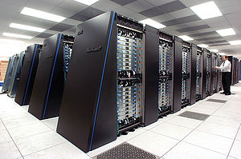

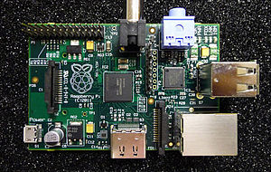
What are they?
Supercomputers
Cheap
Readily available

Slide 4
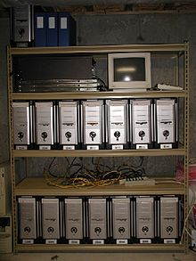

More Specifically…
Free OS – Linux
Windows cluster
Parallel Computing Platform
Message Passing Interface
Parallel Virtual Machine
1 server
Many slaves
LAN

Slide 5

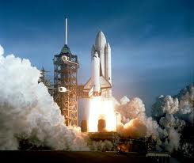
So who made them first?
NASA Project
1994 – Don Becker and Thomas Sterling
Small slice of the large pie
The whole pie to yourself
10.1 Gflops/s
Floating point instructions per second

Slide 6
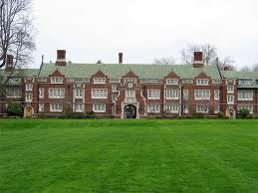


Who makes them now?
Colleges and Universities
Businesses
Électricité de France
200 Tflops/s
Ranked 43 out of 500
U.S. Government

Slide 7


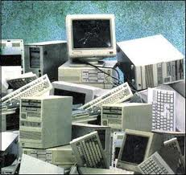
What they are good for
Research
$1/hr vs. $4000/cluster
Parallel Computing
Scalability
Compatibility
Power Savings
1/10th
Independence
No proprietary software
Investment vs. performance
Bramble – $424 / 5.8Ghz
$48 / Gflop

Slide 8
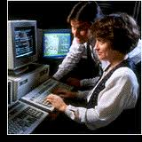
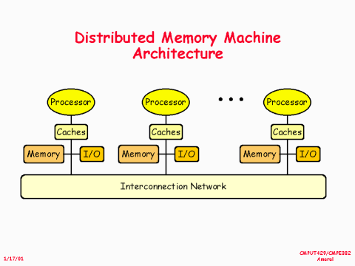
Where they are lacking
Large scale adoption
Coders
Parallel Computing Requirement
Shared vs. distributed memory processor
2006 and not really

Slide 9
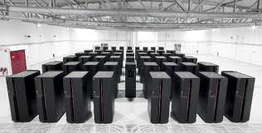
But what about computer x?
Peak performance vs. measured performance
Supercomputers
Manufacturers report peak
Lucky to get 50-60% of peak
Clusters
Report peak
Measured performance almost = peak

Slide 10
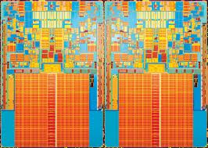
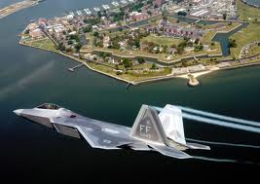
Why should you care?
The Air Force has developed their own Beowulf Clusters
PS3 Cluster
1760 PS3 and 168 General Purpose Processors
$2Mil - 10-20x cheaper
5 Tflops
“Green”
Our budget isn’t getting bigger
Our computing requirements are though!

Slide 11
Documentation
http://en.wikipedia.org/wiki/Beowulf_cluster
http://www.escapistmagazine.com/news/view/105767-U-S-Air-Force-Finishes-PS3-Supercomputer-of-Epic-Proportions
http://yclept.ucdavis.edu/Beowulf/aboutbeowulf.html
http://www.debian.org/News/2011/20110729
http://phys.org/news148749271.html
http://www.calvin.edu/~adams/research/microwulf/FAQ/
I did not receive help on this assignment

